Slide 1
Ilmington Community Shop Limited
Fifth Annual General Meeting
Ilmington Village Hall
19.00 21st January 2019

Slide 2
Introduction & Agenda
Introduction to the format of the meeting: Tim Allen, Company Secretary
Apologies for absence: Belinda & David Derrington / Wendy & Colin Lewis Edwards
To receive the Chairs Report for the trading year to 30th September 2018: Tim Allen
To receive the Treasurers Report for the trading year to 30th September 2018: Mark Dobson.
To approve Ilmington Community Shop Financial Statements to 30th September 2018 prepared by David Cadwallader and Co Ltd (accountants retained by Ilmington Community Shop Ltd): Mark Dobson.
Consider and vote on the Management Committees recommendation that Ilmington Community Shop Limited does not require the appointment of an auditor: Mark Dobson.
Consider and vote on a proposal that for future AGMs Annual Accounts are provided in electronic means only and not printed in hardcopy.
Consider progress since 30th September 2018, including financial projections for the current trading year (1st October 2018 – 30th September 2019): Mark Dobson & Tim Allen.
To consider and advise on ethical questions raised by members and customers around the sale of certain products / the use of plastics etc.: short presentation by the committee followed by discussion.
To receive a brief membership strategy, consider and vote on the strategy: Tim Allen.
To elect the Management Committee for the coming year: Company Secretary to facilitate.
Any other business and close (we will close by 8.30pm at the latest).

Slide 3
Chair’s Report to 30th September
Third full year for the shop and second for the cafe.
Shop
Treasurers report will amplify, but a challenging year with fluctuating returns.
Operating in a challenging retailing context e.g. food price inflation / changing purchasing behaviours.
Improved overall stock control.
Waste / discounting systems working well, but still a challenge to contain waste / discounting.
Bell tower (and bell) restored after lightning strike in 2017: insurance outcome not as bad as expected, and thankyou for the kind donations that helped us both make up the shortfall and afford a lightning conductor – all completed during financial year 2017/18 even if accounted for in 2016/17

Slide 4
Chair’s Report to 30th September
Café
Substantial café growth with more diverse menu: exceeded expectations.
Small core of café volunteers.
Patterns emerging: consistent 33%+ growth in turnover for the financial year, but custom is considerably higher in spring / summer and lower (although fluctuates) in autumn / winter.
Growth means more staff needed, but need caution to match growing staff cost to turnover growth so we have to be incremental and review on a 6 month basis.
Renewed 5 star award for environmental health.
Contributed to Open Gardens June 2018 on Saturday afternoon.
Positive Trip Advisor Reviews

Slide 5
Chair’s Report to 30th September
Overall:
Mantra for last AGM remains – no place for complacency
Volunteer numbers holding up well (despite a perception otherwise?)
But, we are pursuing stricter safeguarding policies which is more demanding of volunteer time so we need more.
Communications – in 2016 the AGM advised more input and activity: thanks to Angie Dobson’s lead and Michele and Jeanette’s efforts we believe these are doing well
A while back Nicky & I were asked to be advisers for the Plunkett Foundation: since then we have helped some 20 shops and cafes: we believe we compare well with many, but a valuable learning opportunity too.
Despite the challenges, we often host other shops & cafes, or prospective shops & cafes and they frequently express shop and café envy!

Slide 6
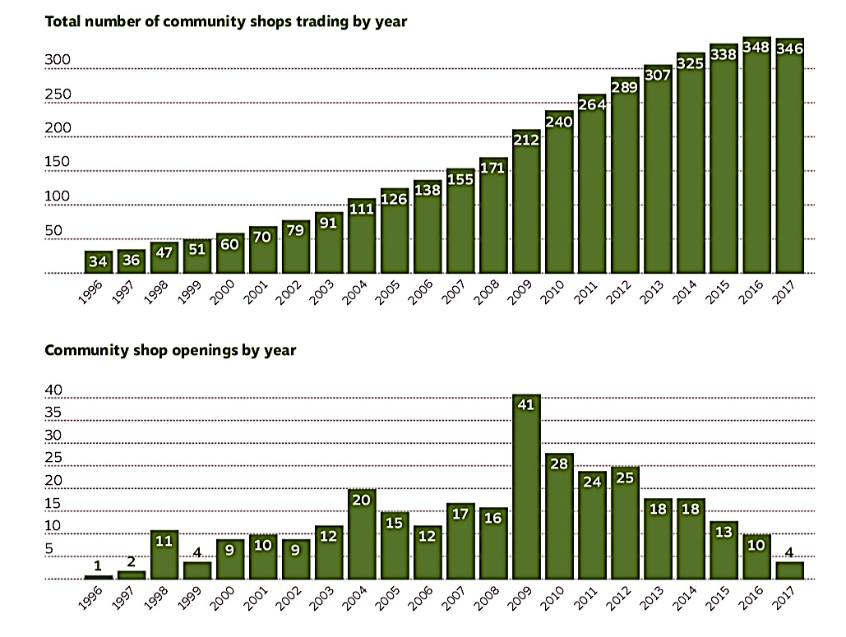
Community Shops & Cafes: Some Context

Slide 7
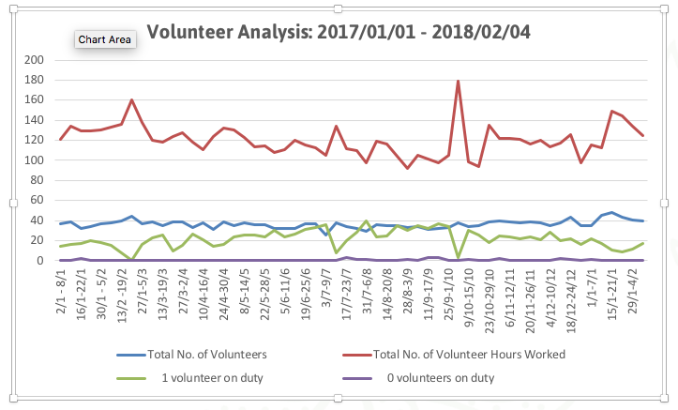
Volunteer Analysis

Slide 8
Volunteer Analysis: Sep – Nov 2018

Slide 9
Progress Since September 2018
Shop
Systematic product group reviews e.g. sweets / cakes etc.
Changes in presentation and using the front of the shop more creatively to showcase.
Excellent Christmas performance and sales in shop.
Cafe
Café custom and turnover continues to grow in comparison with the same period last year (20+% to end December 2018).
Café winter pattern seems to be consistently popular lunchtime, less predictable outside these hours.
Planning for café staffing for spring / summer 2019.
General
Starting to get on top of essential maintenance and repair.
Have a list of planned maintenance, replacement items & improvements, but need to fund raise to deliver these – e.g. have raised £1,600 to replace outdoor tables and chairs, but much more to do.
Too many people by far to list individually and to thank, but warm thanks to all who have helped this venture in so many ways both last financial year and since.

Slide 10
Questions & Vote
Members are invited to:
Ask questions; and then
Vote to accept the Chairs report for the year October 1st 2017 to September 30th 2018.
Opportunity to ask questions and discuss progress post 30th September 2018

Slide 11
Treasurers Report

Slide 12
Comparison 2018 v 2017
 | Year Ending 30.09.17 | Year Ending 30.09.18 | Variance
Turnover | 248,755 | 263,042 | 14,287
Gross Profit | 67,970 | 79,184 | 11,214
% | 27.3 | 30.1 | 2.8
Overheads | (60,443) | (79,491) | (19,048)
Profit / Loss | 7,527 | (307) | (7,834)
Depreciation | (25,193) | (25,443) | (250)
Capital Grant | 1,760 | 1,760
Lightening Strike | (4,062) |  | 4,062
Donations |  | 6,100 | 6,100
Profit / Loss | (19,968) | (17,890) | 2,078
Shop | 208,947 | 210,045 | 1,098
Cafe | 39,808 | 52,997 | 13,189

Slide 13
Analysis of Overheads 2017v 2018

Slide 14
Shop Sales

Slide 15
Cafe Sales

Slide 17
Treasurers Report
Targets for 2018 / 2019
&
Performance since 30th September 2018

Slide 18
Comparison of 2018 Actual v 2019 Target
 | Year Ending 30.09.18 | Year Ending 30.09.19 | Variance
Turnover | 263,042 | 276,197 | 13,155
Gross Profit | 79,184 | 84,063 | 4,879
% | 30.1 | 30.4 | 0.4
Overheads | (79,491) | (83,100) | 3,609
Profit / Loss | (307) | 963 | 1,270
Depreciation | (25,443) | (21,252) | 4,191
Capital Grant | 1,760 | 1,752 | (8)
Lightening Strike
Donations | 6,100 |  | (6,100)
Profit / Loss | (17,890) | (18,537) | (647)
Shop | 210,045 | 217,901 | 7,856
Cafe | 52,997 | 58,296 | 5,299

Slide 19
Comparison of 2019 Target v Actual 2019
 | Target to 31.12.18 | Actual to 31.12.8 | Variance
Turnover | 68,755 | 70,436 | 1,681
Gross Profit | 20,282 | 21,170 | 888
% | 29.4 | 30.0 | 0.6
Overheads | (19,626) | (20,392) | (766)
Profit / Loss | 656 | 778 | 122
Shop | 57,168 | 56,965 | (203)
Cafe | 11,587 | 13,471 | 1,884

Slide 20
Shop Sales Target 2018/19

Slide 21
Cafe Sales Target 2018/19

Slide 22
Shop & Café: Action Planned
We need so sustain and improve shop performance so:
As mentioned previously:
We are working on shop front presentation.
Communications (e.g. Facebook / Instagram)
We have designed a survey to ask households why they don’t use the shop & café and what might induce them to do so plus ask existing customers what they like / don’t like / want etc.
More and regular promotions (worked well for Christmas)
Be more persuasive in terms of communications (e.g. average ‘shopping bag’ to induce people to think shop).
Bring together a short term task and finish group of business oriented colleagues / members to help us sharpen up plans.
Need to get people spending ‘a little bit more’

Slide 23
Questions & Vote
Members are invited to:
Ask questions, advise on steps to encourage more custom / spend; and then
To approve Accounts and Balance Sheet for the period to 30th September 2018.
Audit Arrangements: we have the accountants David Cadwallander & Co Limited independent accountants opinion on the accounts (see above) we recommend to Members that an independent audit is unnecessary

Slide 24
Questions & Vote
Proposal we normally:
Print copies of the annual accounts for the AGM
Post on the Shop & Café Website in advance
Make available in hard copy in the shop and café on request.
Printing costs £100+
Motion:
Members are asked to consider and vote on a proposal that for future AGMs, Annual Accounts are provided in electronic means only and not printed in hardcopy.

Slide 25
Necessary or Desirable Expenditure Over the Next 12 – 24 Months
Item | Estimated Cost £s
Renewal of Lights in shop to LED | 2,700
Vegetable chiller for shop | 2,500
Update office computer / Back office software | 2,500
Treating cafe exterior | 1,500
Shed for storage | 600
Car Park – Gravel for car park and to make more accessible | 500
Counter Chiller in Cafe | 400
General repairs & maintenance e.g. Painting, new shelving | 600
Total | 11,300
Plus Roof Repairs | tbc
Outside Chairs & Tables (600 Grant + 1,000 donation received) | [1,600]

Slide 26
Necessary or Desirable Expenditure Over the Next 12 – 24 Months
Need to fund raise, so:
Seek grants.
Village events.
A share offer.
Seek a new Committee member (or a committed volunteer) to lead on fund raising in addition to kind help offered by Colin Lewis Edwards

Slide 27
Member Strategy
The Society is a member owned: members have a voice in the direction of the business & provide a pool of people to draw on for the Management Committee, and for volunteering. Our Rules require a membership strategy: our Strategy is:
To engage the Community: we do this through volunteer events, email, 20/20 communications, and social media.
A membership newsletter circulation.
To permanently open to new Members (from June 2016) to ensure that people who move in and out of the village, or use the shop and café, can join as and when.
Formal communications, e.g. AGM and Management Committee documents are available in the shop on request, and on the website.
Volunteering: we have a strong group of volunteers and are aware that we need effective communication and support: for example, feedback events.
Continue to actively recruit volunteers and encourage volunteers to ‘do’ a regular slot to help managers and reduce their time in staffing the shop and café.

Slide 28
Member Strategy
Members are invited to:
Ask questions and offer views, and then to:
Endorse this broad strategy.

Slide 29
Environment, Sustainability & Ethics
Members & Volunteers have raised various questions about:
Use of plastics in the shop & café and can we reduce (20/20 conducted a plastics audit in 2018)
The sale of specific products e.g.:
Children’s magazines with cheap plastic toys.
Products containing unsustainably sourced palm oil
Tobacco.
Magazines with particular content (e.g. the Fortean Times)
Waste disposal (e.g. food products)
Too many sweets etc.
General policies around the choice of items for sale on health, environmental or other grounds.

Slide 30
Environment, Sustainability & Ethics
Our current policies are to:
Offer a broad based product range (the Mary Poppins handbag ’philosophy’).
Offer ‘ethical’ product alternatives where possible; but
Not to extend this have a product based policy that excludes certain products such as tobacco although we do not, for example, sell pornography.
Try to minimize our broad environmental foot print e.g. sourcing local products where we can, minimizing waste, and for example, use an air source heat pump for heating etc.
Act on the plastics audit (albeit more slowly than we would like)
Explore whether some products such as washing up liquid can be topped up using customers existing containers.
Welcome and engage with all and everyone in a way that respects diversity and the individual and to have a strong sense of commitment to the fact that this is a community owned and run service.

Slide 31
Environment, Sustainability & Ethics
This is a complex set of questions which we the Management Committee believe is appropriate for Member consideration and guidance so:
We invite Member views to initiate a conversation.
We are not putting any formal motions together at this stage, rather gathering evidence and views.
The Management Committee will consider views and input as a step in either re-affirming our current policies or proposing changes dependent on Member views and further input.

Slide 32
Management Committee Membership
AGM quorate if 39 Members or more (including the current Management Committee) are in attendance.
One member one vote.
Voting by a show of hands.
Members unable to attend the AGM may nominate another member who can vote at the meeting on their behalf by proxy,
Members voting by proxy identify themselves.
All members may nominate another Member to be on the Management Committee
Society Rules allow a min of 4 Management Committee members and a max of 10.

Slide 33
Name | Term Start | Term End | Nomination | Start Date If Appointed | End Date if Appointed
Tim Allen | 2018 | 2021 | N/A | N/A | N/A
Mark Dobson | 2016 | 2019 | Yes | 2019 | 2022
Nicky Schlatter | 2016 | 2019 | N/A | 2019 | 2020
Lee Bridges | 2017 | 2020 | N/A | N/A | N/A
New Nominations
 |  |  | Jackie Prosser | 2019 | 2022
 |  |  | Fiona Dakin | 2019 | 2022
Resignations / Term Completion
Angie Dobson | 2017 | 2020
Claire Simmons | 2018 | 2019
Sarah Beebee | 2018 | 2021
Sheila Lowe | 2018 | 2021
Sabatical
Liz Morris

Slide 34
Management Committee Membership
Votingings as follows:
Are Members content to vote en-bloc: Yes / No?
If yes: Members are asked to vote to renew Nicky Schlatter (1 Year), Mark Dobson (3 Years) and Jackie Prosser (3 Years): if no
Members will be asked to vote for all nominees individually.

Slide 35
Management Committee Membership
Management Committee Succession Planning:
Committee membership is not a trivial task and can be quite demanding.
However there are rewards.
But, the shop and café are heavily reliant on the committee, much of which is about that bit of the iceberg that is under water (however, we are not the Titanic…!).
We do urge that you consider joining us if not now, then in the foreseeable future.
Several core roles have been occupied for some years and at some stage those individuals will need to stand down.
If possible, those committee members will give good notice before resigning, but the future is unpredictable…..

Slide 36
Minutes From 4th AGM 15th February 2018
Fruit & veg: concerns about produce quality and presentation depleting as a result of how they are currently stored: have discussed option of an additional chiller.
Request for more variety of fruit & veg please - aware that our suppliers have a wide variety displayed in their own shop: acted on.
Review of margins on spirits: as shop prices are significantly higher in comparison to competitive stores: acted on and reviewed sales.
Should we consider closing shop & café earlier during winter months: yes for café 2018/19 and yes for shop for 2019/20 (ref also Christmas).
Also open the café from 10-1 on Sundays, as often turn away custom at 12pm. NB: we are currently bound by planning permission to close both shop and café at 1pm: worth doing.
Do volunteer have access to open the tills in both the shop & café: yes: a response to recent robberies & the need to minimize risks to volunteers or customers, after taking advice from crime prevention officers.

Slide 37
Any other Business?
Open forum: questions?
AoB?
Thank You & Close

